Slide 1

Project Title – Seasonal Agriculture Performance Analysis
ABHAY
Indira Gandhi National Open University (IGNOU)
AICTE STU ID : (STU6a0da24a763d81779278410)

Slide 2

PROBLEM STATEMENT
Agricultural activities are influenced by seasonal variations in environmental conditions, farming practices, resource availability and market conditions. As a result, agricultural performance may differ from one season to another. However, raw agricultural data does not dearly explain how agricultural performance changes across seasons or what pattems can be observed in different seasonal conditions. The problem is to analyze the given agricultural dataset and investigate seasonal differences in agricultural performance by identifying meaningful patterns, trends, relationships and variations within the available data

Slide 3
Project Description [The project analyzes 4,000 agricultural farm records across 3 seasons: Kharif, Rabi and Zaid. The dataset covers environmental conditions, soil nutrients, irrigation, fertilizer/pesticide use, crop production and financial performance. The workflow includes data cleaning, exploratory analysis, seasonal comparison, relationship analysis, statistical testing and visualization. The goal is to convert raw agricultural records into evidence-based insights for better seasonal planning. ]

Slide 4

WHO ARE THE END USERS?
Farmers and small-scale growers - understand seasonal yield, cost and profitability patterns.
Agricultural planners and extension teams compare seasonal conditions and resource requirements
.Agribusiness and market stakeholders - identify economically stronger crop-season combinations.
Researchers and data analysts - investigate relationships between environmental conditions and agricultural outcomes

Slide 5

Technology Used
Python — core programming language for data analysis.
Pandas & NumPy — data cleaning, transformation and numerical analysis.
Matplotlib & Seaborn — charts, comparisons and correlation visualization.
SciPy — statistical hypothesis testing.
Google Colab / Jupyter Notebook — project execution and documentation.
Dataset

Slide 6
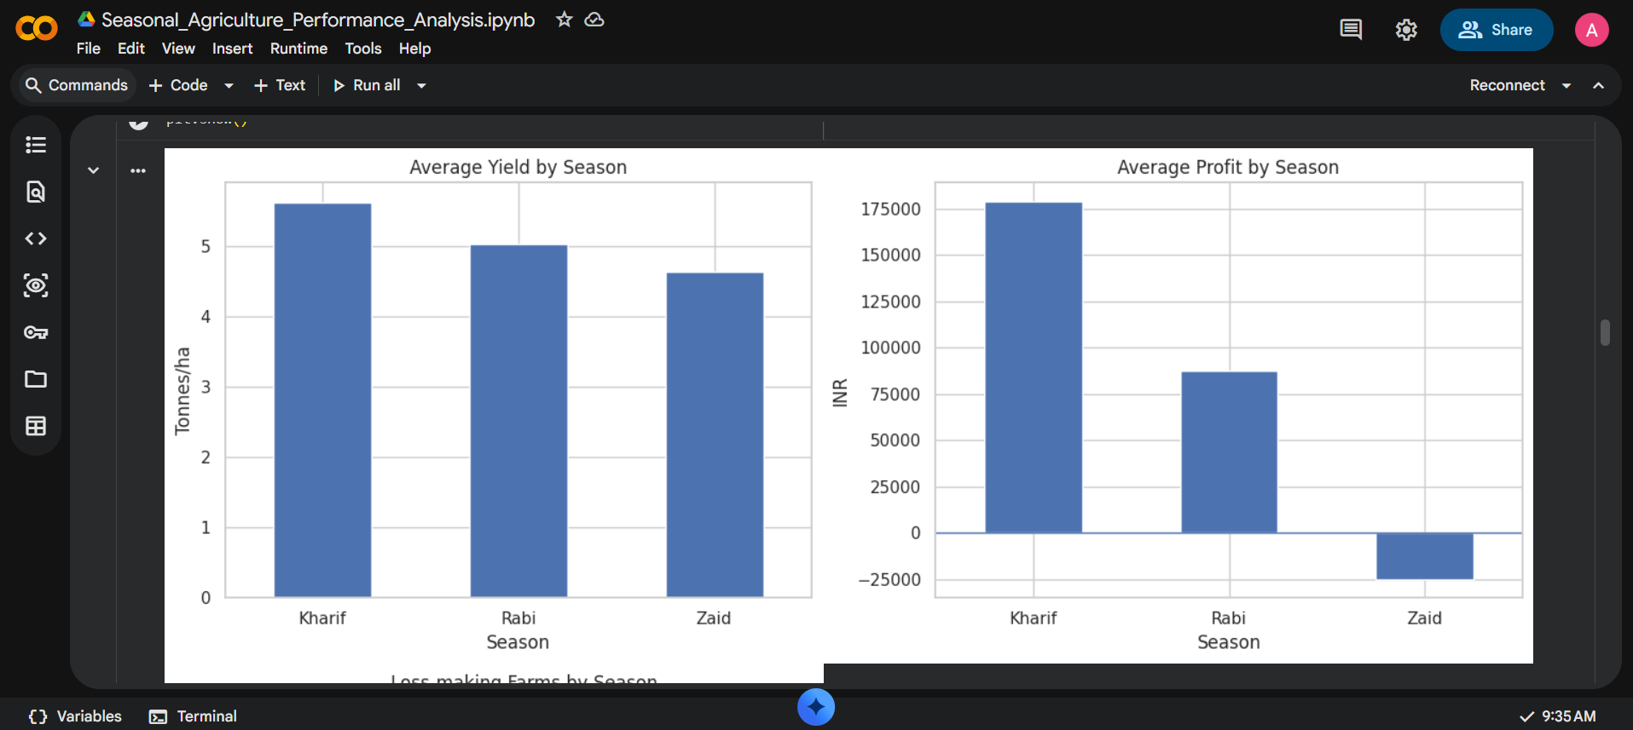
RESULTS

Slide 7
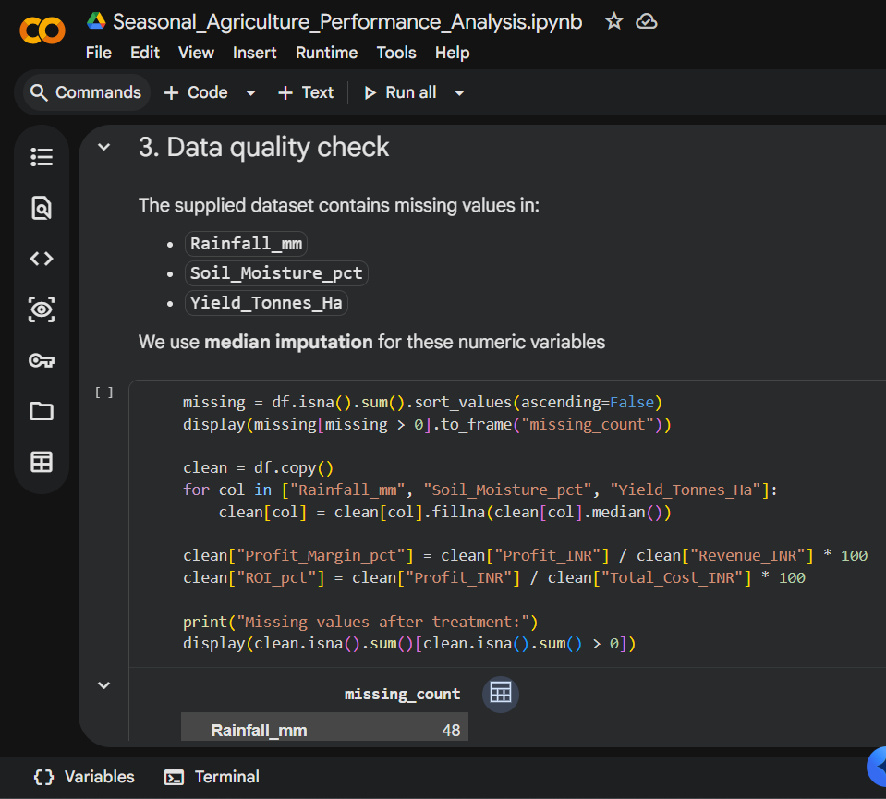
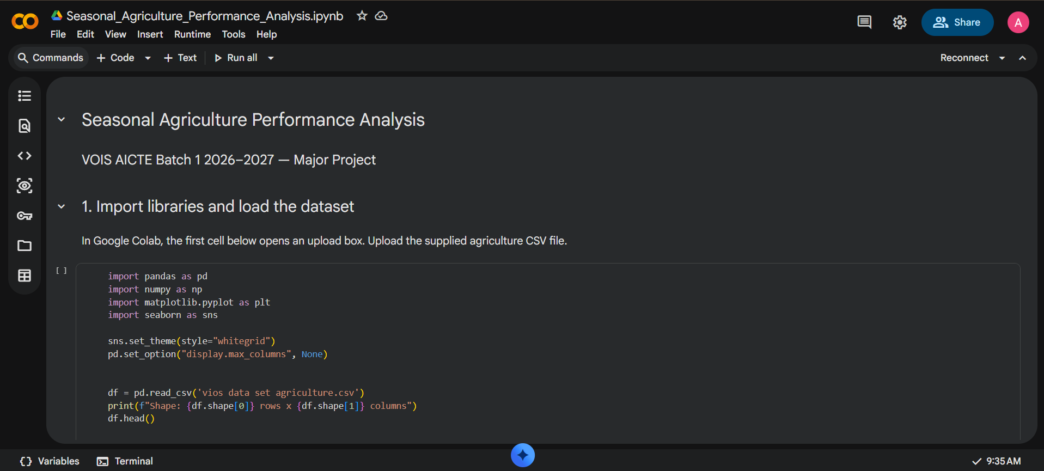
RESULTS
[screen shots of code ]

Slide 8
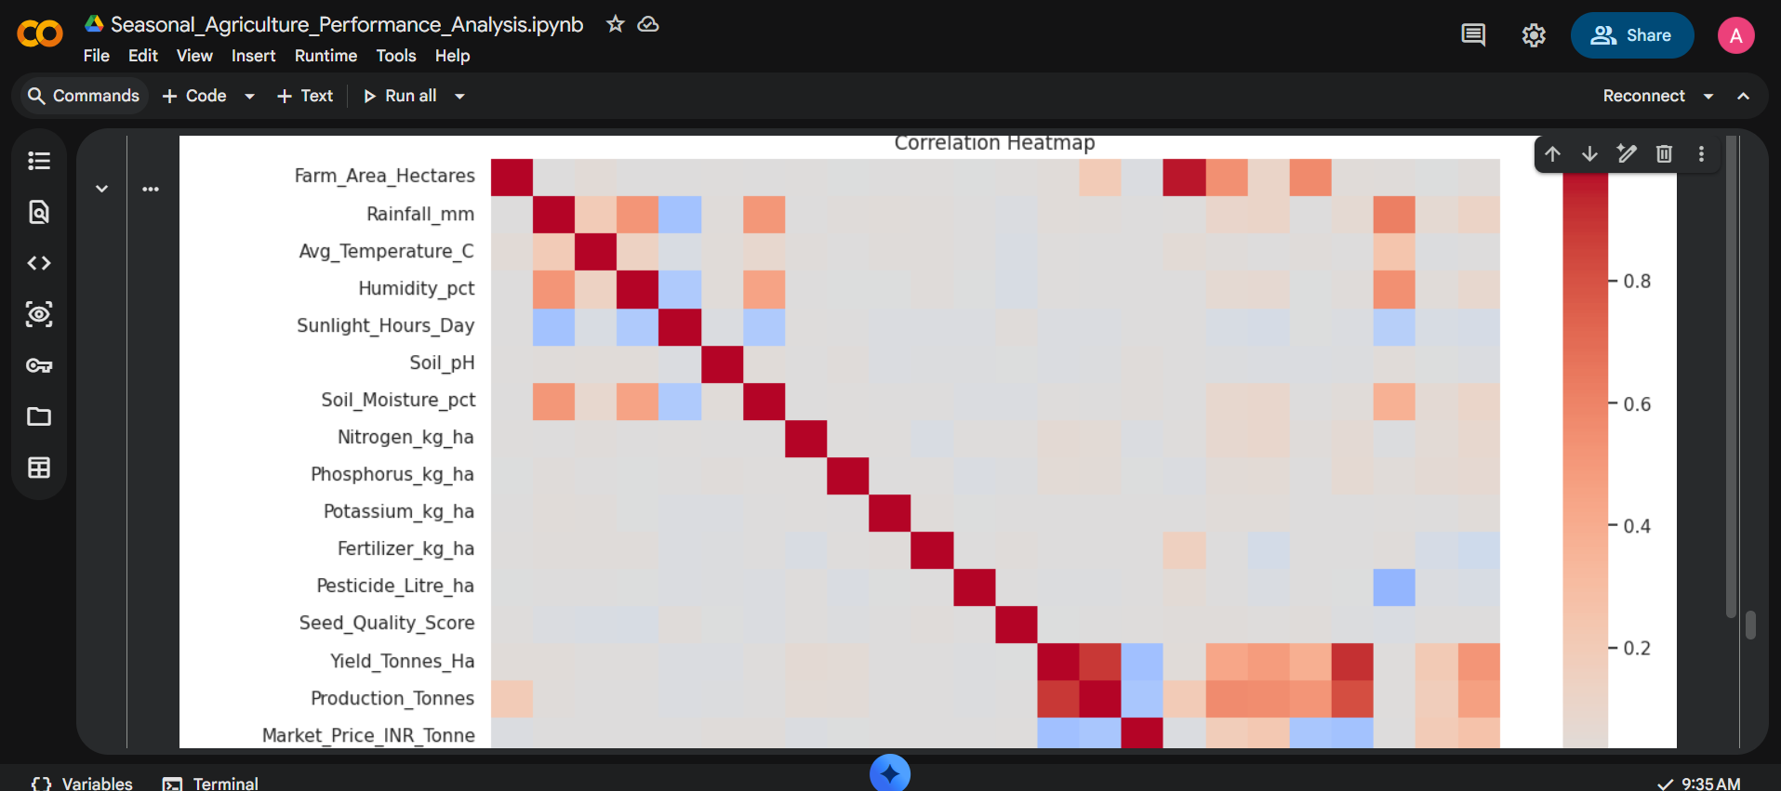
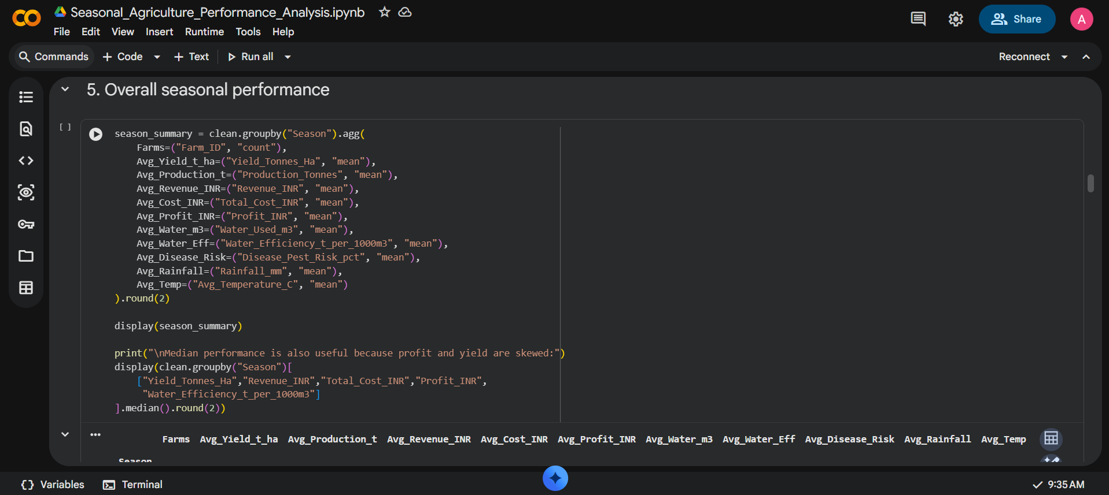
RESULTS
[Add screen shots of your code ]

Slide 9
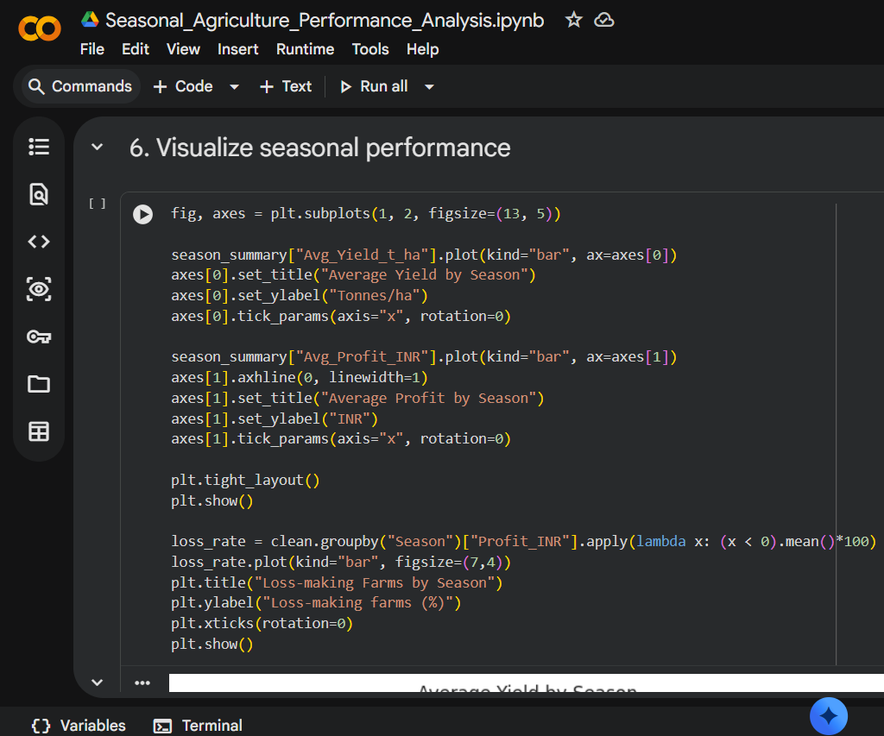
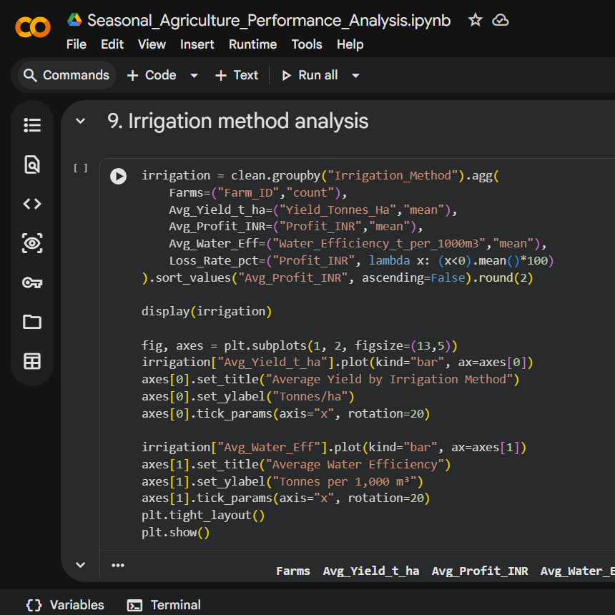
RESULTS
[Add screen shots of your code ]

Slide 10
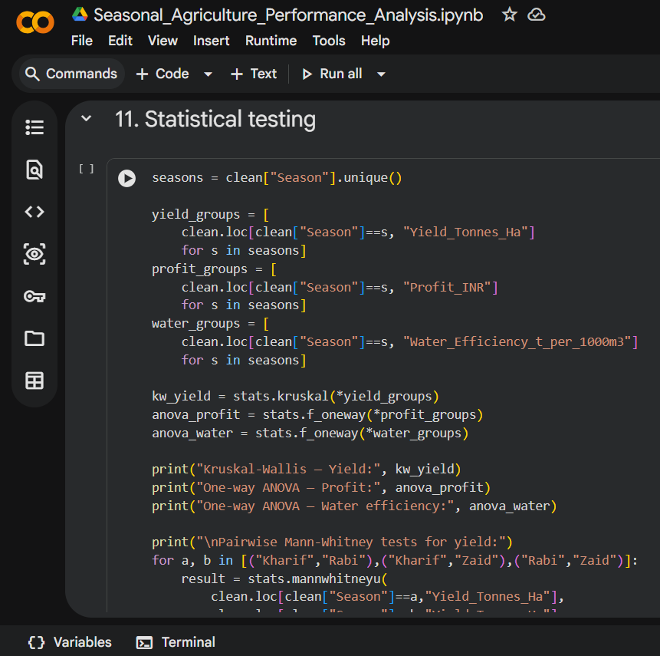
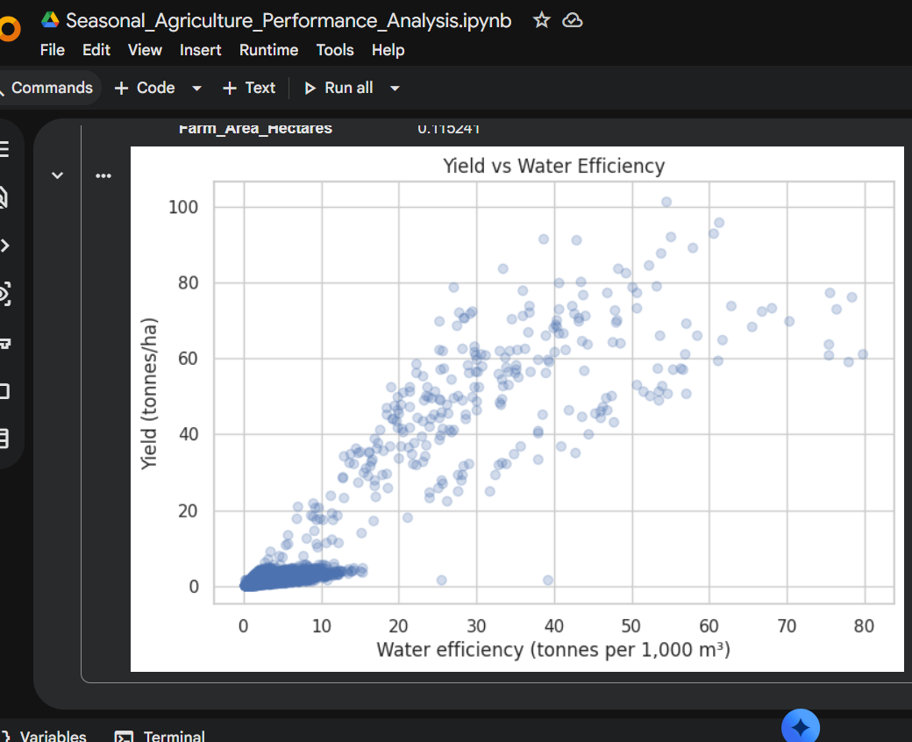
RESULTS
[Add screen shots of your code ]

Slide 11
Future scope
Build a seasonal prediction model for crop yield and profitability.
Add real-time weather and market-price data for dynamic recommendations.
Create crop-specific models instead of one overall yield benchmark.
Use geospatial analysis for state/district-level seasonal comparisons.
Evaluate irrigation methods with matched or experimental data to study causal effects.
Create an interactive dashboard for farmers and agricultural planners.

Slide 12
GitHub Link
https://github.com/abhaykukreti125-stack/Data-analysis-

Slide 13
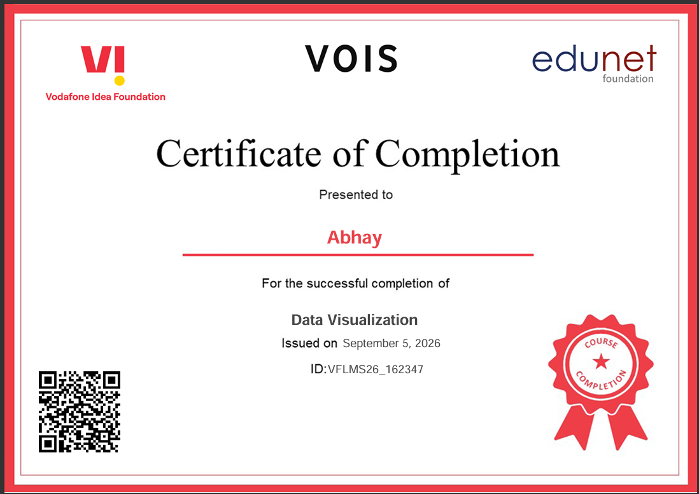
VOIS Course completion certificate - Course name- Data Visualization

Slide 14
Thank you
By Abhay
.
.

